Slide 1

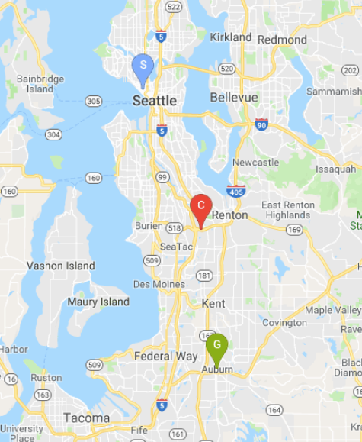

HALFWAYTHERE.US by Ceberus +1
Pablo rosales
Ray ruazol
Roger huba
Tanner seramur

Slide 2
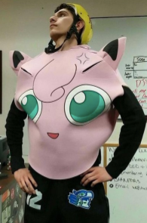
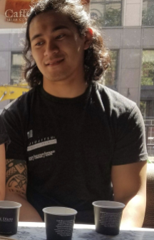
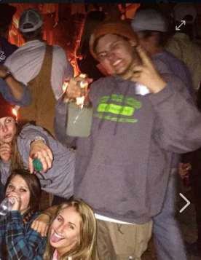
Team Introduction
Pablo
Ray
Roger
Tanner

Slide 3

Problem Domain
Given 2 user locations, find a meetup point halfway between the 2 users.
Given a venue type, find a location at the halfway point.

Slide 4
Contributions
Calculation for halfway point
MAPS
SSL Certificate for security
What to save

Slide 5

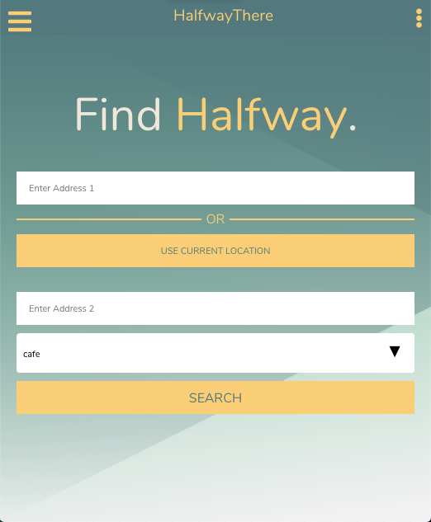



Application Demo

Slide 6
Given Additional Time
User Login
Text / Notification to both users
Additional People to meetup.

Slide 7
Questions / Comments

